Slide 1
Hadoop 1st Example WordCount
Kurt Friedrich
Winter 2018

Slide 2
Book 1
Book 2
Book 3
a dark day indeed
day started as a good day indeed
indeed, it was indeed a good day
Node 1
Node 2
< indeed, 1> < it, 1>
< was, 1>
< indeed, 1>
< a, 1>
< good, 1>
< day, 1>
< a, 1> < dark, 1>
< day, 1>
< indeed, 1>
< day, 1> < started, 1>
< as, 1>
< a, 1>
< good, 1>
< day, 1>
< indeed, 1>
Node 3
< day, 2> < started, 1>
< as, 1>
< a, 1>
< good, 1>
< indeed, 1>
< indeed, 2> < it, 1>
< was, 1>
< a, 1>
< good, 1>
< day, 1>
< a, 1> < dark, 1>
< day, 1>
< indeed, 1>
< day, 4> < started, 1>
< as, 1>
< a, 3>
< good, 2>
< indeed, 4>
< dark, 1>
< was, 1>
< it, 1>
MapperClass
CombinerClass
ReducerClass

Slide 3
Without learning java, we’ll try and see what is going on with this app
JAR (Java Archive) is a package file format typically used to aggregate many Java class files and associated metadata and resources (text, images, etc.) into one file to distribute application software
Class StringTokenizer: A token is returned by taking a substring of the string that was used to create the StringTokenizer object. Example:
StringTokenizer st = new StringTokenizer("this is a test");
while (st.hasMoreTokens()) {
System.out.println(st.nextToken());
}
prints the following output:
this
is
a
test

Slide 4
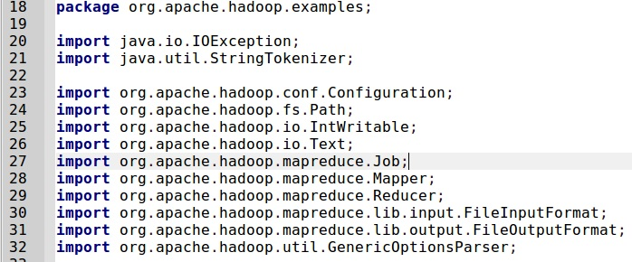
Source Code: starts with “Using” statements
We will need this method for our code
Use lots of supplied Hadoop methods

Slide 5
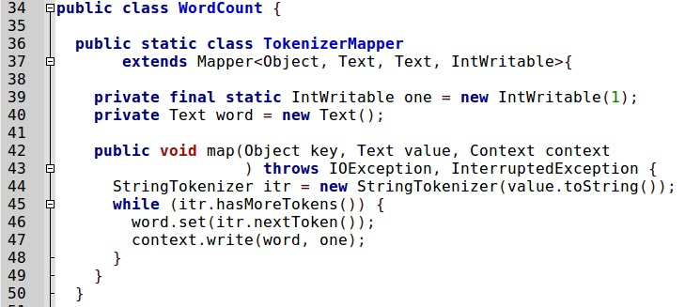
Here we define what we want the Map phase to do.
Class has our methods
First comes our mapper method
The keyword final, in this context, means that you cannot update the implicit pointer one to point to a different object (although you can modify the object pointed to by one)

Slide 6
The mapper: maps a book of words into 1 key value pair for each word
takes lines of text that are fed to it
(the text files are automatically broken down into lines by Hadoop--No need for us to do it),
and breaks them into words.
Outputs a datagram for each word that is a ( String, int ) tuple, of the form ( "some-word", 1),
since each tuple corresponds to the first occurrence of each word, so the initial frequency for each word is 1.
processes one line at a time, as provided by the specified
TextInputFormat.
It then splits the line into tokens separated by whitespaces, via the StringTokenizer, and emits a key-value pair of < <word>, 1>. E.g.
< Hello, 1> < World, 1>

Slide 7
This WordCount example code also specifies a combiner phase before the reducer phase.
The output of each map is passed through the local combiner (which is done using the same method as the Reducer as per the job configuration) for local aggregation, after being sorted on the keys.
Effectively giving us more parallel execution.

Slide 8
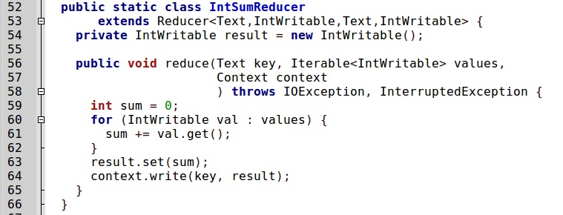
Here we define what we want both the combiner and reducer phases to do.
Then our combiner and reducer method

Slide 9
The reduce section gets collections of datagrams of the form [( word, n1 ), (word, n2)...] where all the words are the same, but with different numbers.
These collections are the result of a sorting process that is integral to Hadoop and which gathers all the datagrams with the same word together.
The reduce process gathers the datagrams inside a datanode, and also gathers datagrams from the different datanodes into a final collection of datagrams where all the words are now unique, with their total frequency (number of occurrences).

Slide 10
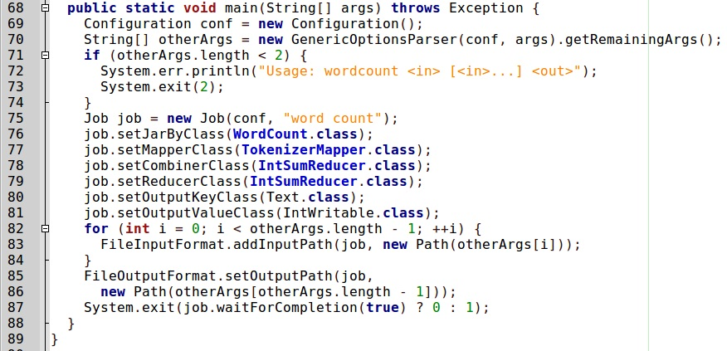
The “main” just like C#, where the computers starts the project.
Say we’ll use our class
Set the method for mapper
Set the combiner method
Use same method for reducer

Slide 11
If you want to poke into Java
A COMPARISON OF MICROSOFT'S C# PROGRAMMING LANGUAGE TO SUN MICROSYSTEMS' JAVA PROGRAMMING LANGUAGE (Detailed)
http://www.25hoursaday.com/CsharpVsJava.html
Java for C# developers (simple chart)
http://it.toolbox.com/blogs/codesharp/java-for-c-developers-21248
Top 10 differences between Java and C#
http://rayli.net/blog/programming/top-10-differences-between-java-and-c/
Also a free PDF book in the Reference Section on Canvas

Slide 12
Homework
Pick another java example in the dir listed below.
Run it like we ran word count
Prepare a PPT description of the java code to explain how it works, include screen shots of the running project and output.
Sources are at
/usr/share/doc/hadoop-0.20-mapreduce/examples/src/org/apache/hadoop/examples/
Suggest
PiEstimator.java
Sort.java
Use RandomTextWriter.java to create 10,000 random words, and then run word count on the result.
SecondarySort.java requires you to build a particular input file.
I had a student in the past do the Sudoku example!!

